Slide 1
Windows 10: The canvas for your next masterpiece
Shawn Weisfeld
shawn@shawnweisfeld.com
http://www.shawnweisfeld.com

Slide 2







About Me
Founder of UserGroup.tv
Azure Technical Evangelist at Microsoft
MCSD: Azure Solutions Architect

Slide 3


Watch User Group presentations for FREE online!
All the topics you care about
Including:
Agile
C#
Entity Framework
HTML5
MVC
Silverlight
XAML
jQuery
and Much More!
Miss a User Group meeting?
Forget something that you learned?
Want to see content from a User Group not in your area?
Want to share with a buddy?
We know you cannot make it to every User Group meeting,
that is why we post them online for you!
We now have over 425 presentations online
That is over 100 GB of video
New Content added all the time!
Presentations from the thought leaders on the topic.
For new content announcements
@UserGroupTV
http://www.UserGroup.tv

Slide 4



Empower every person and every organization on the planet to achieve more
Build the intelligent cloud
Reinvent productivity & business process
Create more personal computing
Notes:
Goal of slide: Transition to setting up the keynote, using 3 ambitions
TPs
Empowering every individual and organization is a bold ambition and has required us to push our platforms forward in bold new ways
We will create more personal computing – Windows 10 is a major step forward
We will reinvent productivity and business processes – Office is no longer a set of individual productivity apps – Office is a platform that enables a rich set of social/mobile experiences
We will build the intelligent cloud - in a world where devices will out number people and data is growing exponentially there is a huge opportunity to build intelligent cloud solutions
Never been a better time to be a part of the MS ecosystem as a dev
With that – want to welcome Scott Guthrie to show you more…

Slide 5


Platform opportunity
Azure
Build the intelligent cloud
Reinvent productivity & business process
Create more personal computing
Notes:
Goal of slide: Transition to setting up the keynote, using 3 ambitions
TPs
Empowering every individual and organization is a bold ambition and has required us to push our platforms forward in bold new ways
We will create more personal computing – Windows 10 is a major step forward
We will reinvent productivity and business processes – Office is no longer a set of individual productivity apps – Office is a platform that enables a rich set of social/mobile experiences
We will build the intelligent cloud - in a world where devices will out number people and data is growing exponentially there is a huge opportunity to build intelligent cloud solutions
Never been a better time to be a part of the MS ecosystem as a dev
With that – want to welcome Scott Guthrie to show you more…

Slide 6







1 Billion mobile notifications a month
Yammer has over 8 million registered users
48 Million Subscribers in
41 countries
Office for iOS has been downloaded over 80M times
Outlook.com has over 400 Million active users and is the world’s fastest growing email service
On average, Skype users use the service 50 Billion minutes/mo
Bing holds 20.2 percent of US market share
- comScore
Over 250 million people use OneDrive
Nearly 50 million Office Online users
Xbox delivered over 740 million hours of entertainment

Slide 7

Hyper-scale footprint
Azure compute regions

Slide 8
19
Azure compute regions open today
Hyper-scale footprint
More than AWS and Google Cloud combined
Azure compute regions

Slide 9
Azure StorSimple
Azure in Open
Azure Government
Azure SQL Database
Rights Management (RMS)
Azure API Management
Azure Site Recovery
Azure Automation
Instance Level Public Ips
Azure Redis Cache
Azure Batch
Azure Marketplace
Azure Data Factory
Stream Analytics
Event Hubs
Operational Insights
Premium Storage
Virtual Machine Converter 3.0
Cloud Platform System (CPS)
Antimalware for Cloud Services and VMs
Identity Manager vNext
Analytics Platform System (APS)
Visual Studio Community 2013
Visual studio 2015 Preview
.NET 2015
Azure RemoteApp
Azure AD Basic
SSD-based instances for Microsoft Azure VMs and Cloud Services
Azure SQL Database Auditing
Live Channels for Azure Media Services
AAD Application Proxy
New experiences in Power BI
Azure DocumentDB
Azure Search
HDInsight for Storm Public Preview & GA
Azure Zone Redundant Storage
HDInsight for Hbase
WSSC vNext tech preview
Content Protection pub preview
Intune - Nov update and Dec update
Azure AAD premium features
Multi-Factor Auth enhancements
Cloudera and Hortonworks on clustered Azure VMs
Azure Instance level IP
Azure Role Based Access Controls
VPN support pub preview
TiP Testing pub preview
Azure AD Workday A148 Integration
Azure Standard SSG
ExpressRoute S2S, P2S GA
Azure Multiple NICs
Azure Networking Appliances
Azure Traffic Manager Nested policies
Azure VM Image Gallery expansion
Azure Vnet
Azure Web Jobs
VSO datacenter expansion
VSO REST Hooks pub preview
Australia datacenter
Forced Tunneling
WSSC Azure Packs
Azure G-Serves Instances
Azure Key Vault
Drivers for SQL Server
MDM for Office 365 public preview and GA
Azure Media Services Content Protection
Azure Mobile Engagement
Node.js Tools for Visual Studio
Visual Studio 2013 updates
Auto-HA for SQL Server VM
Auto-Patching and Backup for SQL Server VMs
Azure SQL Database Increased Compatibility
Azure AD Connect Health pub preview
Azure AD MFA Per App / Conditional access pub preview
Azure RMS controlled user deployment
Azure RMS departmental templates pub preview
Azure Site Recovery SAN Replication
ASP.NET 5 Preview
Azure SDK 2.5.1
Team Foundation Server 2015 preview
Azure Machine Learning GA
Azure HDInsight for Linux Pub Preview
Azure HDInsight Support for Hadoop 2.6 pub preview
Azure SQL Database security feature - Data Masking pub preview
Azure SQL Database security features - Encryption
Azure SQL Database security features - Row Level security
Azure AD: API for SIEM
Microsoft Intune monthly updates
Remote Desktop Client for Windows Phone 8.1
Azure App Service
Azure CDN Integration
Azure Media Encoder Premium
Azure AD Premium & Basic in CSP
Azure IoT Suite
Windows Server Containers
Hyper-V Containers
Windows Server Nano Server
Azure Media Player GA
Azure Service Fabric
Azure IoT Suite
Azure Site Recovery: Protect VMWare and Physical Servers in Public Preview
Azure Backup Generally Available
Azure API Management Premium simplifies high availability and massive scale for APIs
ExpressRoute for Office 365
Azure Active Directory Dynamic Membership For Groups
Automatic Password Change for Social Media Shared Accounts
Compute-Intensive A10 and A11 Virtual Machine Instances
Remote Desktop app for Windows Phone support for Gateway and Remote Resources
Informatica Cloud Agent availability in Linux and Windows Virtual Machines
Azure DocumentDB Hadoop Connector
Azure HDInsight support for more VM sizes
Enterprise-Grade Array-Based Replication and Disaster Recovery with ASR and System Center GA
500+
New releases in
the last 12 months
Notes:
112

Slide 10
Azure momentum
>90,000
New Azure customer subscriptions/month
>20%
Customer VMs
are on Linux
>50 Trillion
Storage objects in Azure
425 Million
Azure Active Directory Users
3 Million
Developers registered with Visual Studio Online
1.4 Million
SQL databases in Azure
Notes:
What we are seeing as we expand our feature set and footprint around the world we see the usage of Azure rapidly grow.
We have more than 90K new customers subscriptions being created every month, and those customers are creating some amazing applications.
More than 1.4 million SQL databases are being used by applications hosted inside Azure.
We have over 50 trillion objects stored in the Azure storage system.
425 Million users in the Azure AD system.
3 Million developers registered with our Visual Studio Online services which are an online suite of our SaaS offerings.
We are seeing the growth and traction of Azure happen but not just in the Enterprise as over 40% of our revenue now comes from Start-ups and ISVs.

Slide 11
b
c
a
Elastic Database Pool
SQL Data Warehouse
Data Innovations
SQL Database
Data Lake
Notes:
Azure Data Services are a comprehensive set of services to support all of your application and analytic applications.
Azure SQL Database
Robust relational database service backed with an SLA of four 9s and a host of security features. Auditing, Row Level Security Dynamic Data Masking and now Transparent Data Encryption make it easy to meet compliance policies.
Simplify SaaS application development and management with a host of new Elastic Database features and services.
Instead of overprovisioning each individual database to meet peak demands, you let Azure dynamically manage database resources and sizing with the Elastic Database Pool. This will give the added benefit of a predictable price model, and in some cases it will save money.
(If you have time… additional bullets to discuss)
Easily and consistently manage schema and data changes to hundreds or thousands of databases with elastic database jobs. Simply submit a script to the pool and Azure manages the successful execution across all the databases in the pool.
Use elastic database query to report across a group of databases with a single connection string and a single query.
Pay for time to insight – not hardware – with Azure SQL Data Warehouse. This is the first elastic data warehouse as a service which can grow, shrink and pause on demand. With SQL Data Warehouse, you get the full benefit of a massive parallel processing architecture to query up to petabytes of data with breakthrough performance.
Keep and store all your valuable data for analytics in the Azure Data Lake, a hyper scale HDFS repository for all types of data – structured and unstructured. No limits on file size, no limits on account size, massive throughput for the more challenging analytic workloads.

Slide 12
Flexibility means…
→ Using the best tools for the job → Leveraging your existing skills/code/investments → Deploying and integrating with multiple clouds

Slide 13
Visual Studio Family
Visual Studio 2015
Visual Studio Code
Other tools
(Eclipse, Xcode, Sublime, IntelliJ, etc)
Most complete developer IDE
Code optimized editor
Visual Studio Online
Agile planning + collaboration tools
Source Control repositories
Bug and work item tracking
Continuous integration builds
Load testing
Application performance monitoring
Available on-premises with TFS
Crash analytics
Free for up to 5 users
Best-in-class tools for every developer
Notes:
Took out ALM as a Service as I thought we may have put it in to balance the text. Added ‘Available on prem with TFS at teams request.

Slide 14
Platform opportunity
Office
Build the intelligent cloud
Reinvent productivity & business process
Create more personal computing
Notes:
Goal of slide: Transition to setting up the keynote, using 3 ambitions
TPs
Empowering every individual and organization is a bold ambition and has required us to push our platforms forward in bold new ways
We will create more personal computing – Windows 10 is a major step forward
We will reinvent productivity and business processes – Office is no longer a set of individual productivity apps – Office is a platform that enables a rich set of social/mobile experiences
We will build the intelligent cloud - in a world where devices will out number people and data is growing exponentially there is a huge opportunity to build intelligent cloud solutions
Never been a better time to be a part of the MS ecosystem as a dev
With that – want to welcome Scott Guthrie to show you more…

Slide 15
1 Billion mobile notifications a month
Yammer has over 8 million registered users
48 Million Subscribers in
41 countries
Office for iOS has been downloaded over 80M times
Outlook.com has over 400 Million active users and is the world’s fastest growing email service
On average, Skype users use the service 50 Billion minutes/mo
Bing holds 20.2 percent of US market share
- comScore
Over 250 million people use OneDrive
Nearly 50 million Office Online users
Xbox delivered over 740 million hours of entertainment

Slide 16





Notes:
We’ve been around a long time and we’ve disrupted together – thanks in large part to the partners in the room, we evolved the operating system market and helped establish Graphical User Interfaces
We changed the word processing and spreadsheet world with integrated productivity in Office
And we changed the datacenter landscape by bringing affordable server software to businesses running on commodity PCs
So we have been a big disruptor in the industry…
…and we have been disrupted a few times as well.
The lessons we’ve learned are evidenced everywhere in the transformation Microsoft is undergoing today
In fact, we are in the middle of a disruption to ourselves right now.
Why would a company with such an incredibly successful software business, reinvent itself?
That is exactly what we did with Office 365.
The 90’s we built the leading productivity software in each category.
In the 00’s we integrated our Office investment and reached to servers with SharePoint and Exchange
Over the last 5 years we’ve been on our latest step to devices and the cloud…
Office is an incredibly successful franchise. Today we serve over a billion users who spend on average 2-3 hours a day with it.
And yet, we knew we needed to shift the business to a mobile first, cloud first business
And today we’ve served over 4 trillion emails with Office 365.
It became one of our most successful businesses to date.
So it’s a great example of how disrupting your existing successful business can succeed.
1.2 billion+ users
2–3 hours/day spent in Office apps
100+ million downloads of mobile apps
850 million meetings are created a month
470+ PB of storage
Over 4 trillion emails sent with O365

Slide 17
Opportunity
850 million meetings are created a month
Over 4 trillion emails sent with O365
100+ million downloads of mobile apps
2–3 hours/day spent in Office apps
1.2 billion+ users
470+ PB of storage

Slide 18









Delve and Office Graph
User
Files
Conversations
People & Groups
Events
FILES
MESSAGES
EMAILS
EVENTS
COLLEAGUES

Slide 19
Platform opportunity
Windows
Build the intelligent cloud
Reinvent productivity & business process
Create more personal computing
Notes:
Goal of slide: Transition to setting up the keynote, using 3 ambitions
TPs
Empowering every individual and organization is a bold ambition and has required us to push our platforms forward in bold new ways
We will create more personal computing – Windows 10 is a major step forward
We will reinvent productivity and business processes – Office is no longer a set of individual productivity apps – Office is a platform that enables a rich set of social/mobile experiences
We will build the intelligent cloud - in a world where devices will out number people and data is growing exponentially there is a huge opportunity to build intelligent cloud solutions
Never been a better time to be a part of the MS ecosystem as a dev
With that – want to welcome Scott Guthrie to show you more…

Slide 20
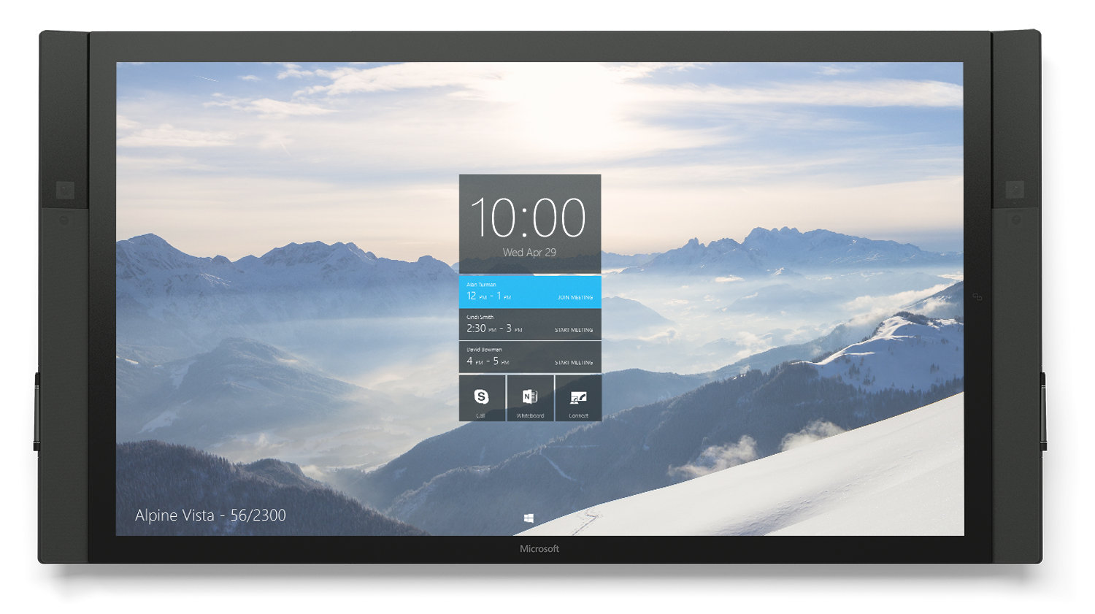
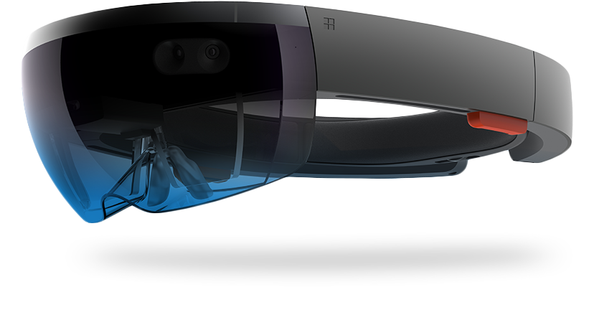
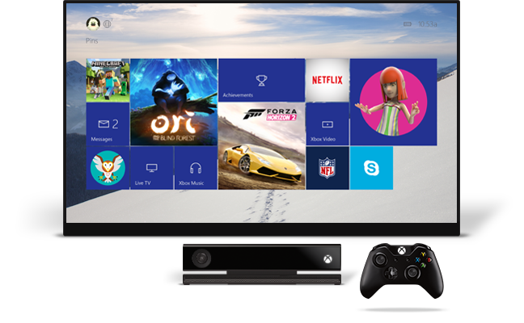
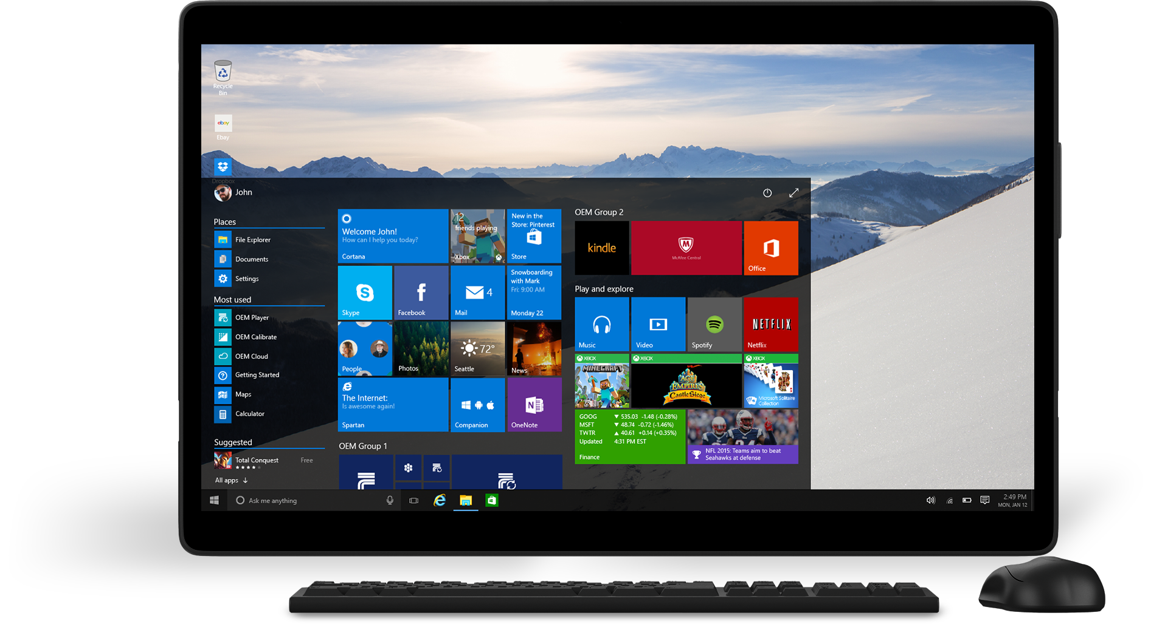
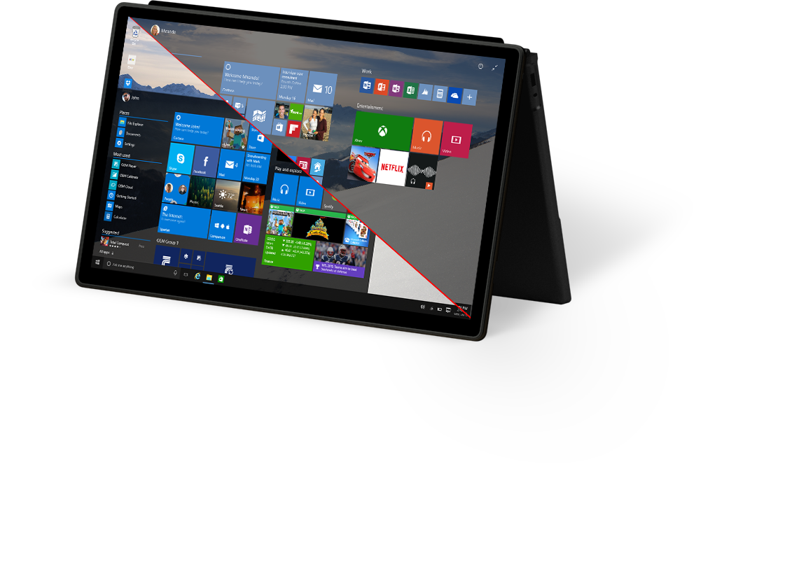
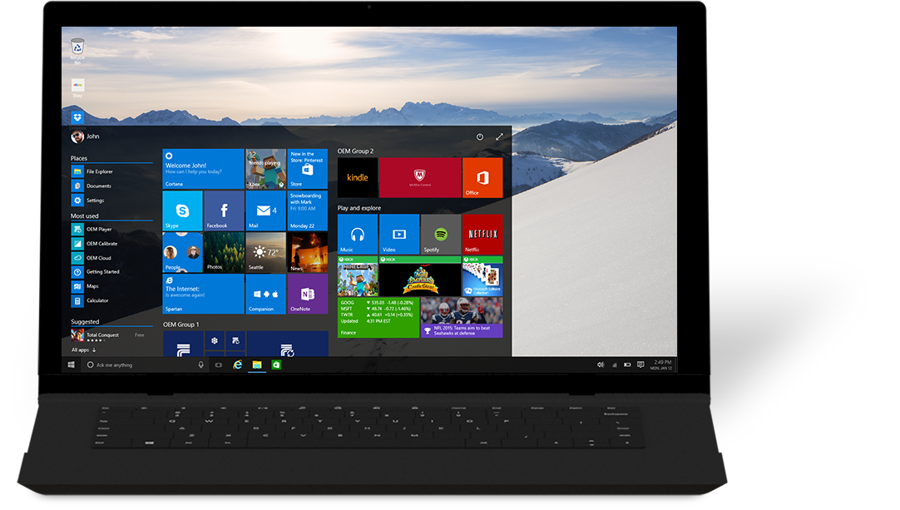
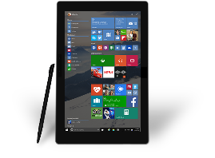
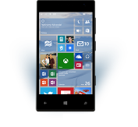



Slide 21
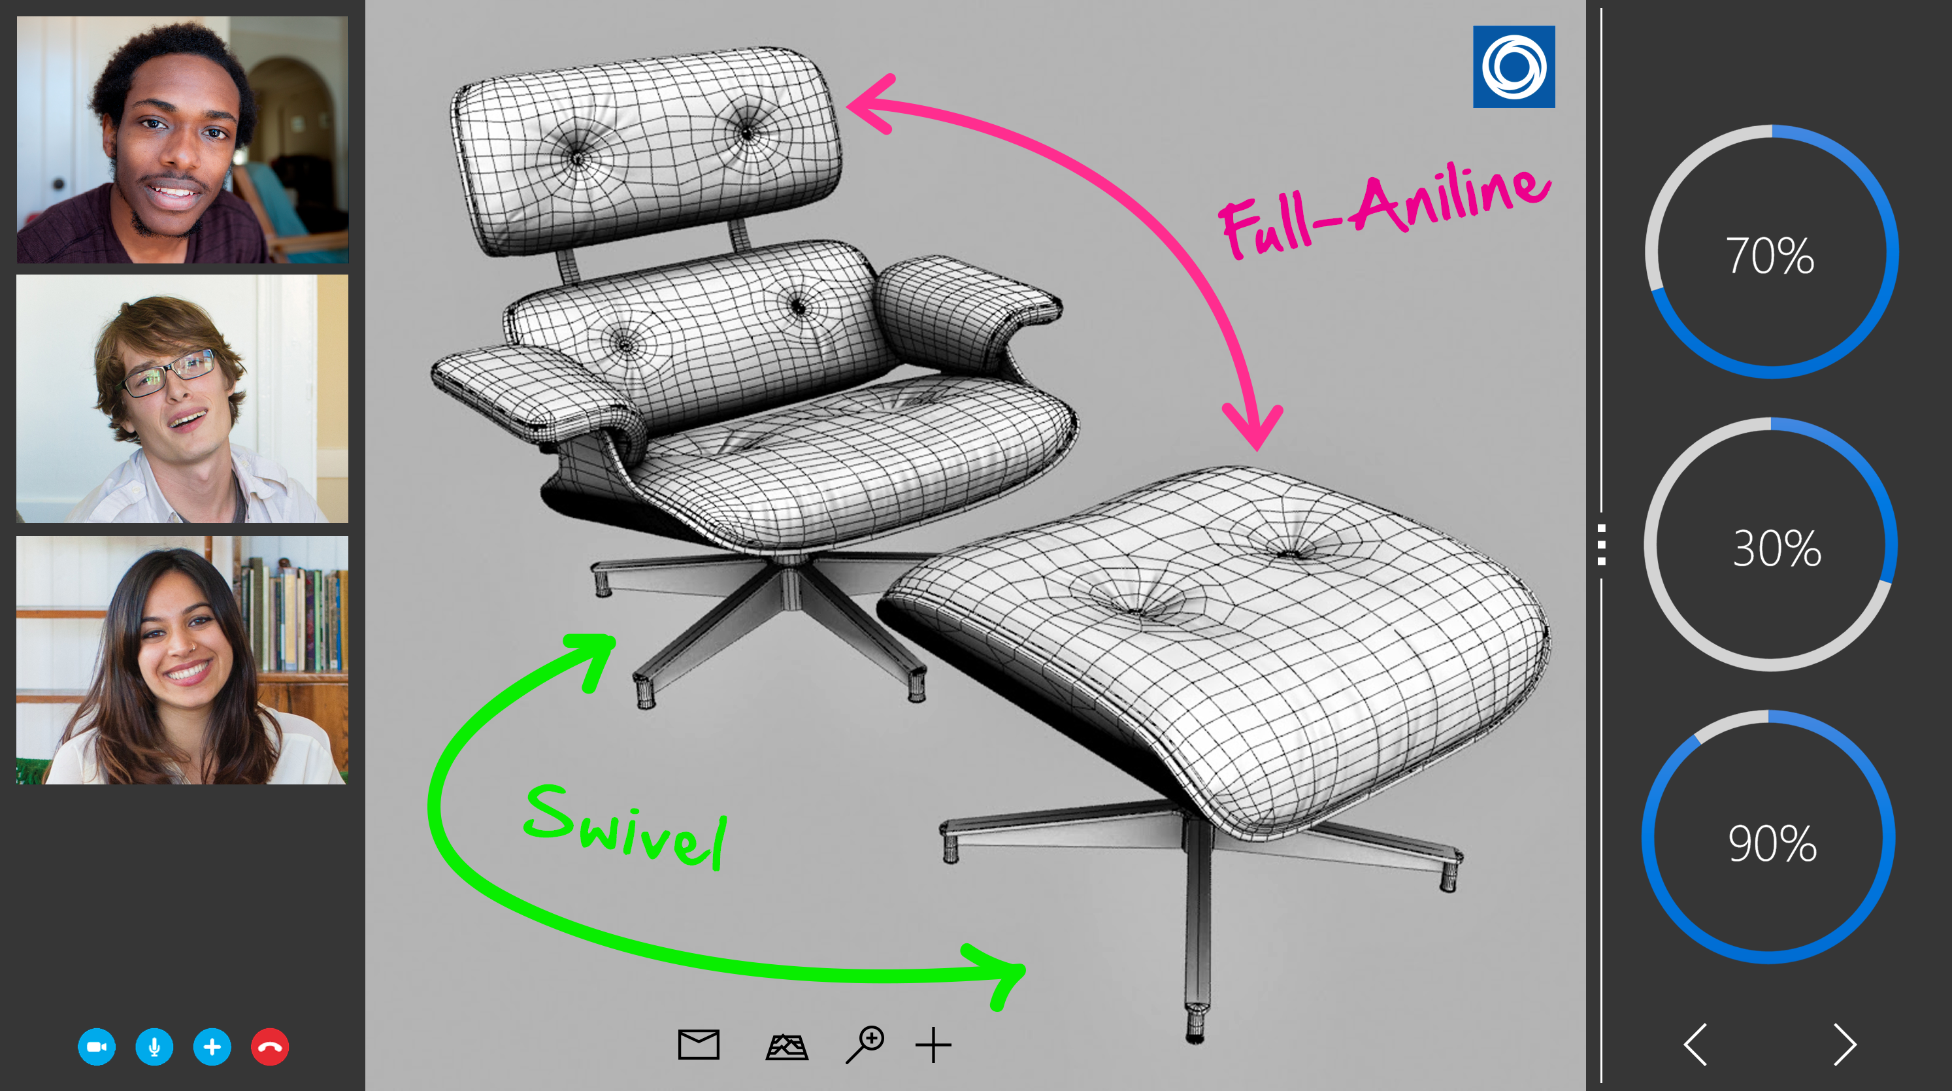
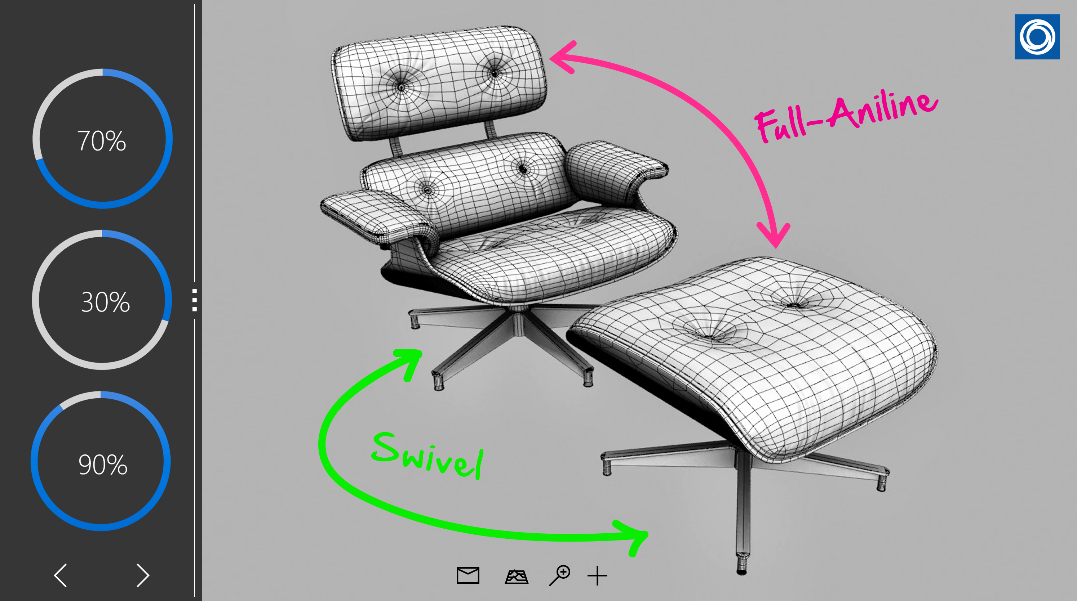
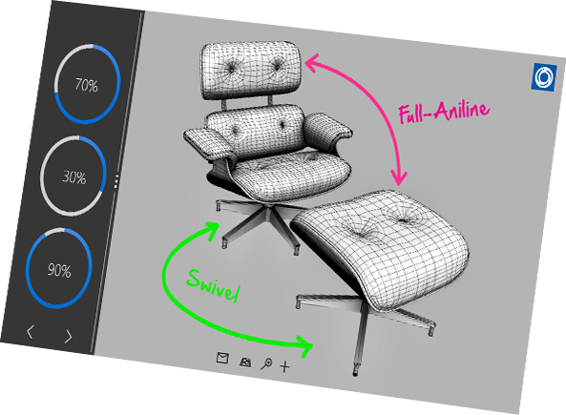


Slide 22

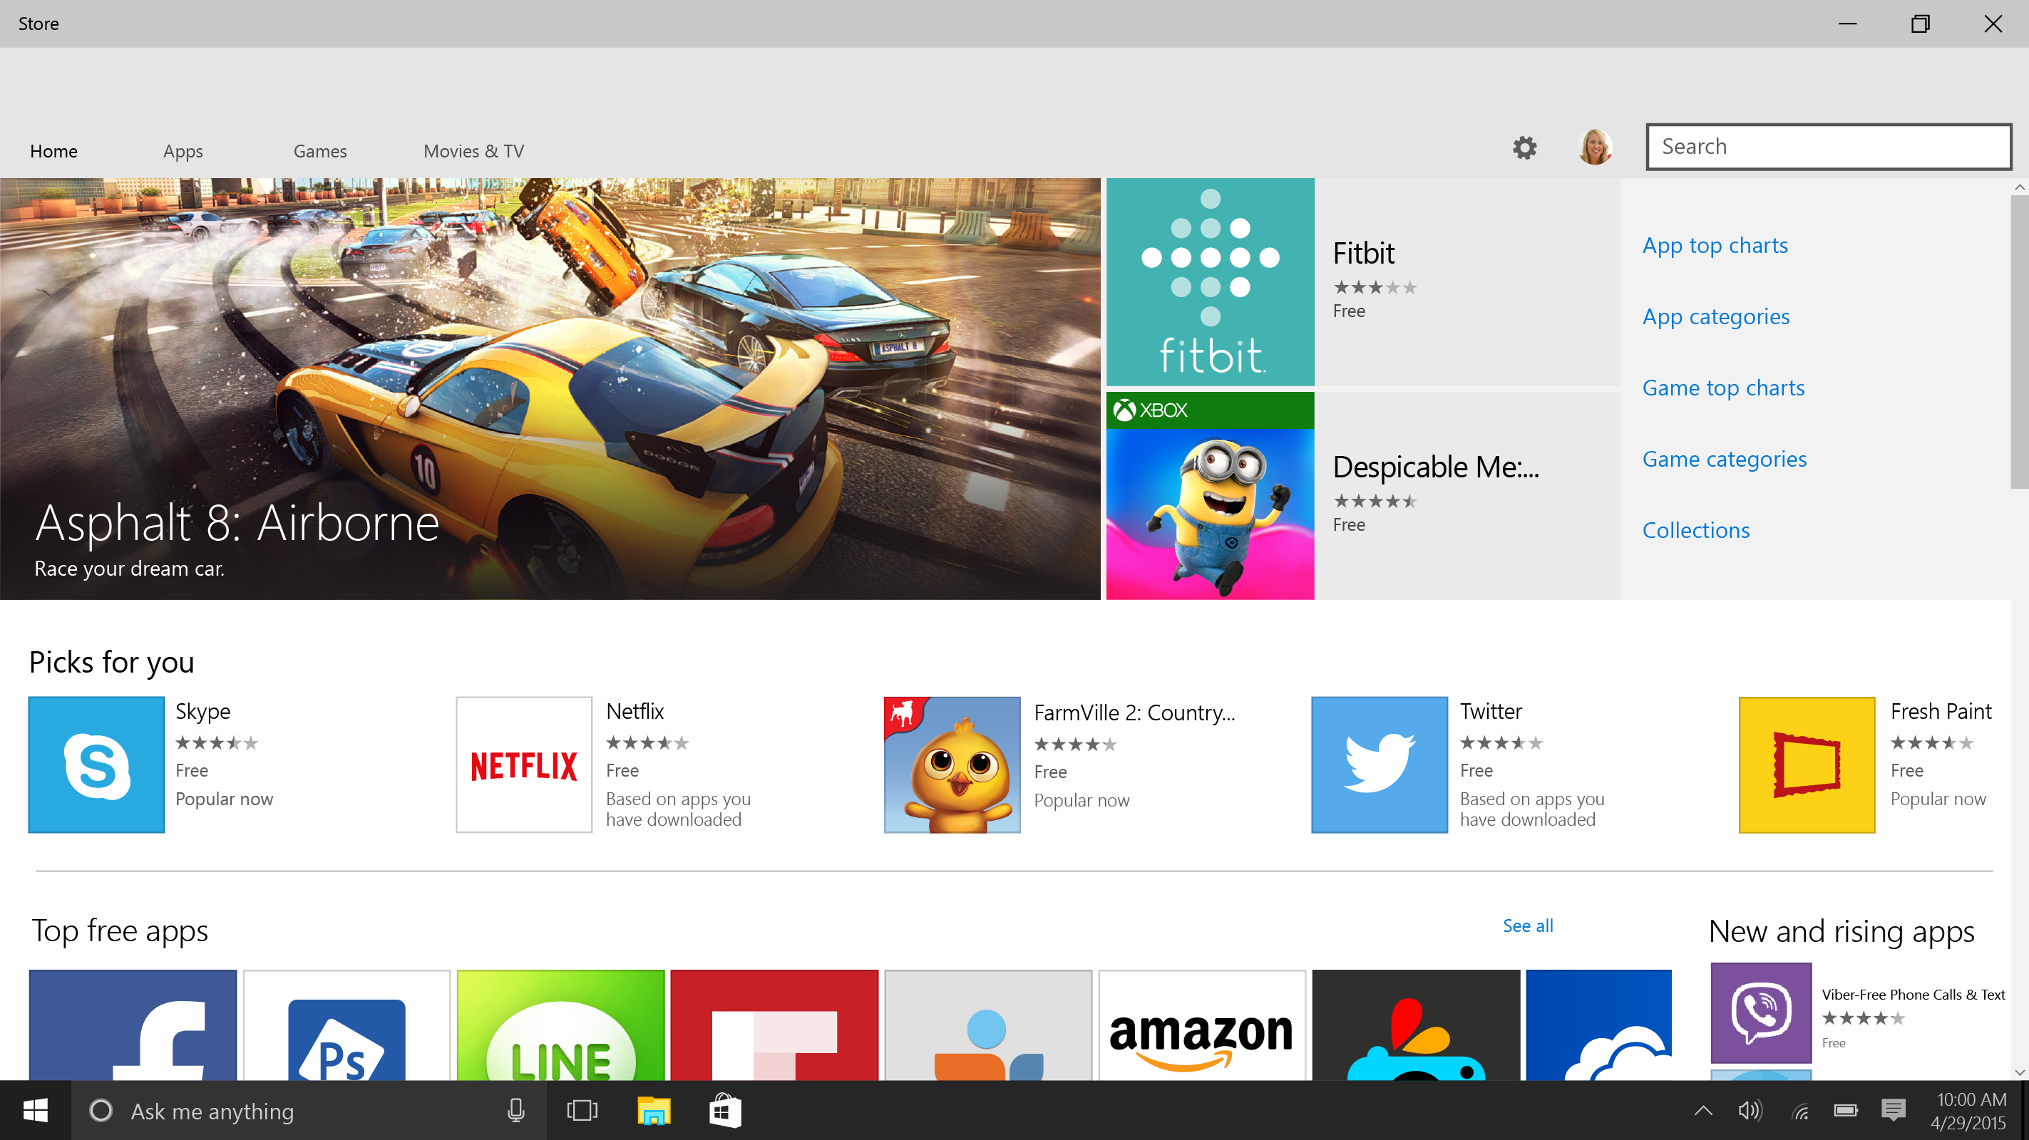
Contoso, Ltd.
8x increase in purchases through carrier billing
Subscriptions
Affiliate referrals
Updated ad SDK with video ads and install tracking
Notes:
Easy to discover, install, uninstall
Mobile operator billing across all windows 10 devices
Subscriptions, affiliate referrals, updated ad SDK with video ads and install tracking

Slide 23
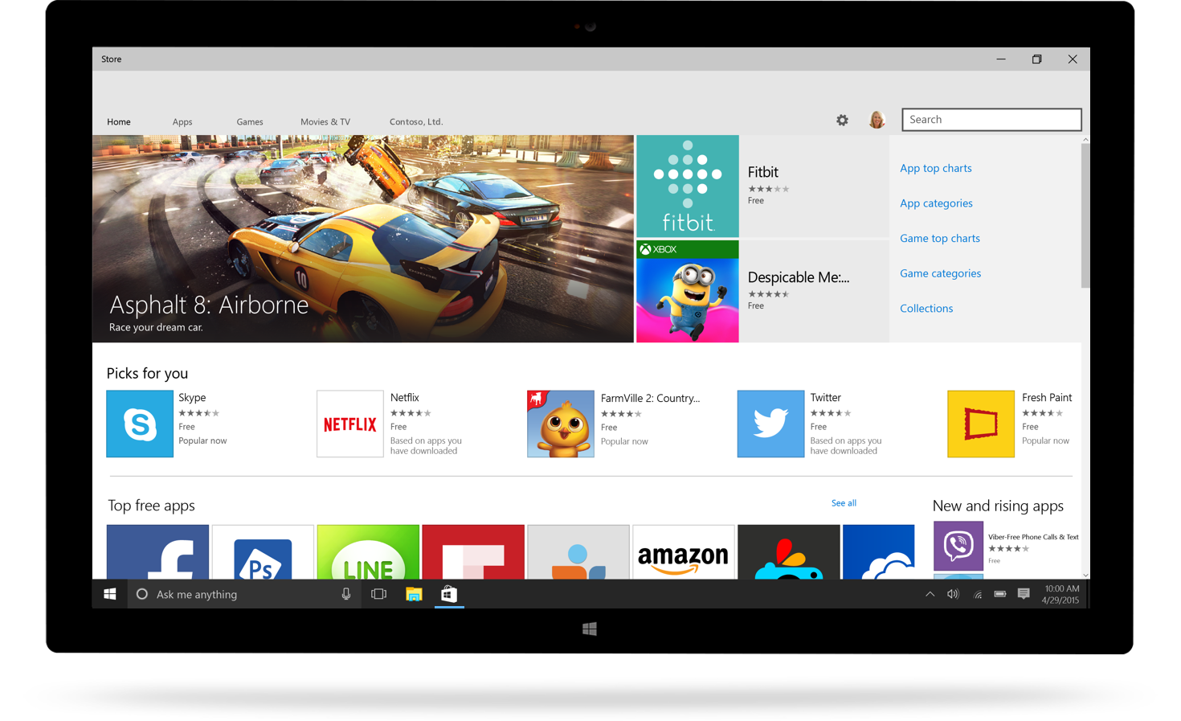
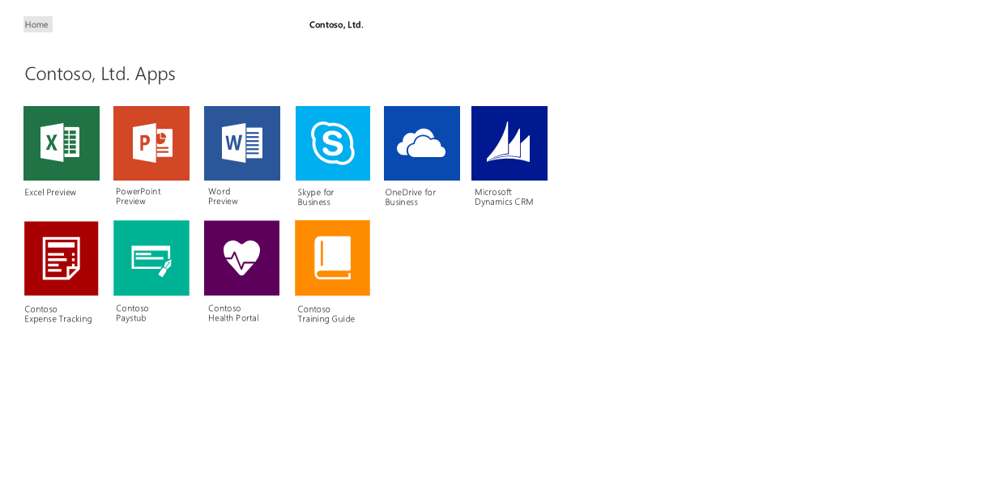
for Business
for Business
Same experience for end users
Highlight consumer apps + private LOB apps
Business payment methods

Slide 24
1 Billion
Windows 10 Devices
Free upgrade for the first year

Slide 25
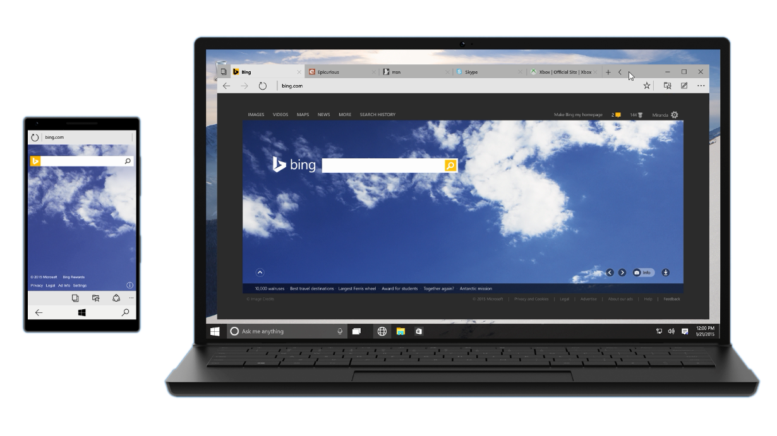
Microsoft Edge
Great new default web browser and rendering engine across all Windows 10 devices
Only browser with Cortana, to get more done on the web
Distraction-free, offline reading Built-in note-taking and sharing

Slide 26
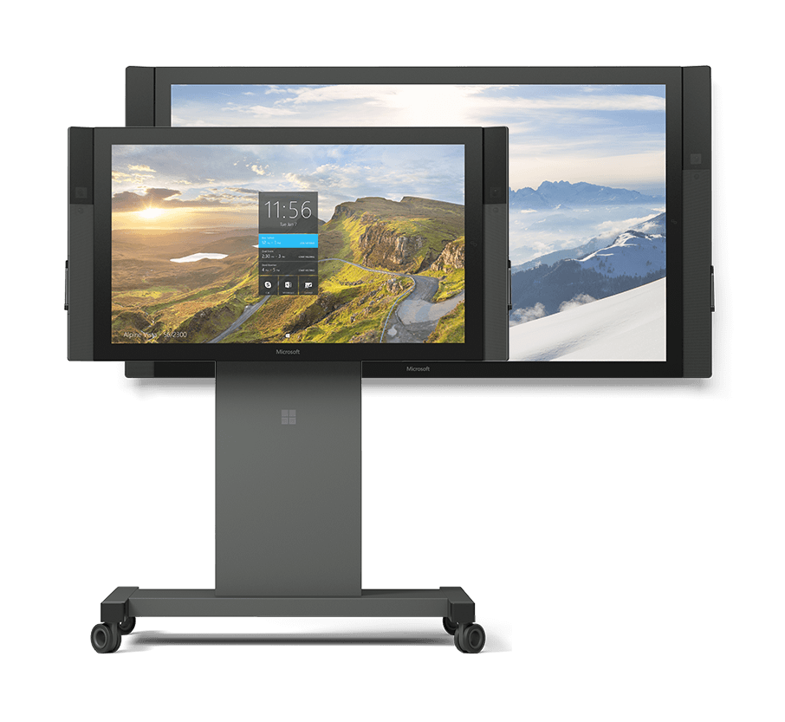
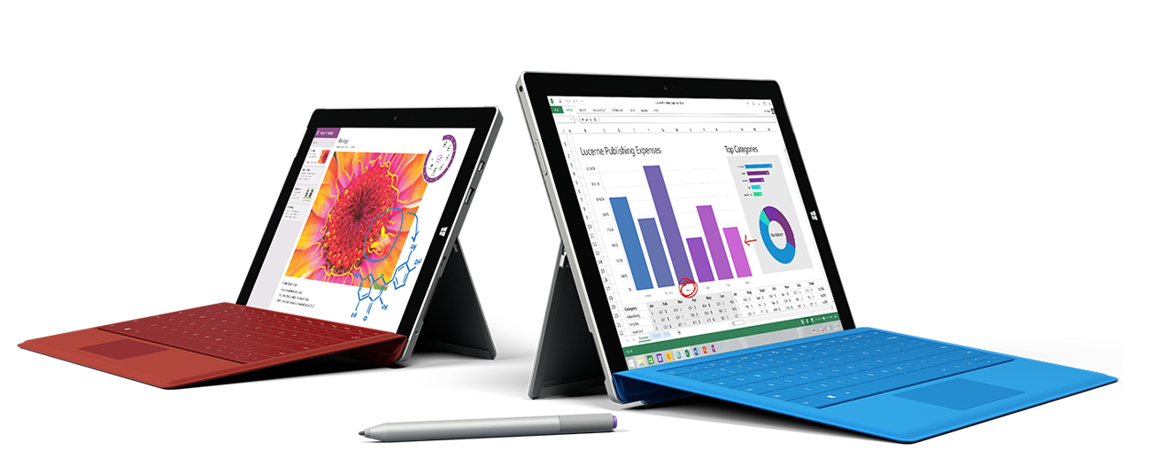

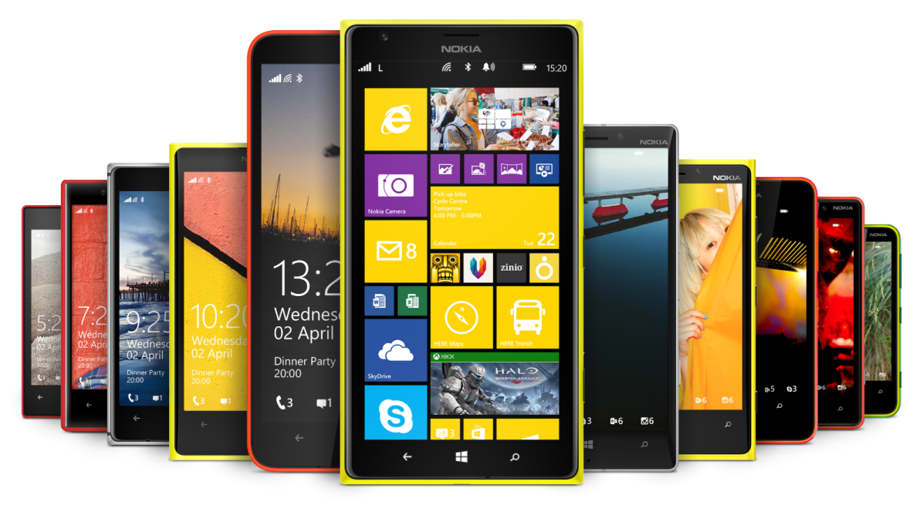

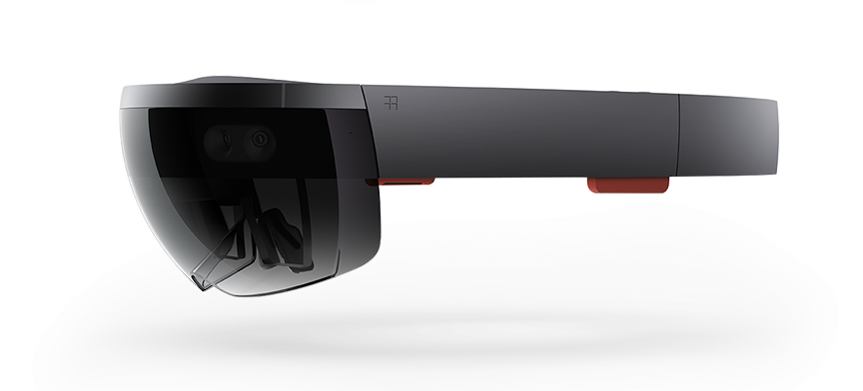
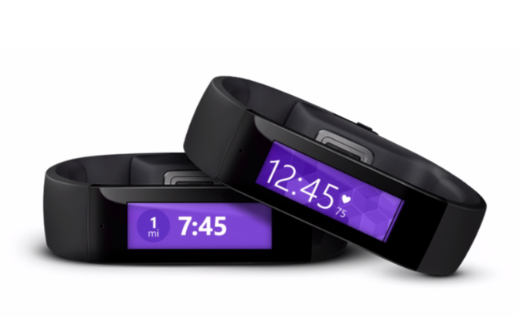
New devices and new partnerships

Slide 27

Notes:
Trimble Video – HoloLens
2 mins

Slide 28
1 Billion Windows 10 Devices
Windows Store
Universal Windows Platform
Android Java/C++
iOS Objective C
Web
.NET & Win32

Slide 29
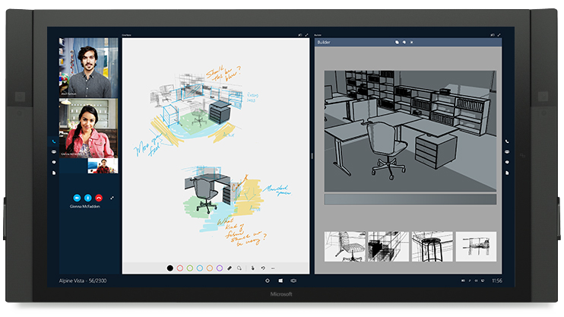
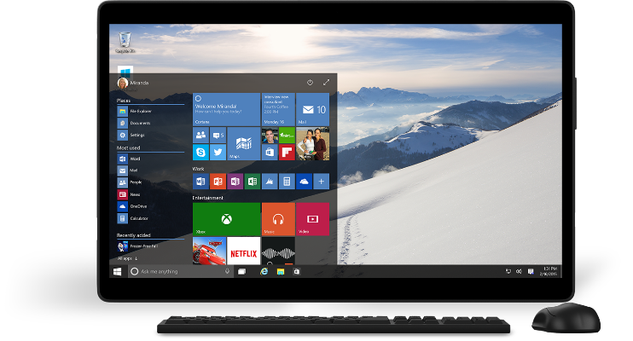
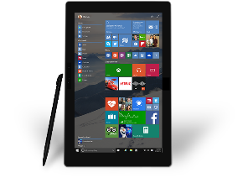
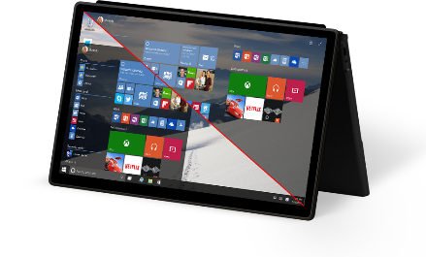

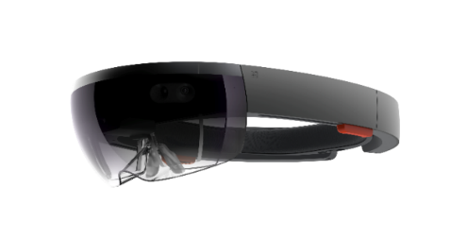
The Windows 10 opportunity
Windows Developer Platform
Growing Reach with Universal Windows Apps
Improving User Engagement

Slide 30

Universal Windows Platform
Wherever your code was born, you can bring it to Windows
Windows Platform
Web Platform
Universal Windows 8 Apps (C++/C#/JS)
Microsoft Edge HTML Engine
Universal Windows 10 Apps (C++/C#/JS)
Surface Hub
Desktop
Cordova Tooling (HTML/JS)
Project Centennial (Classic Apps)
Hosted Web Apps (HTML/JS)
Universal Windows Platform
IoT
Xbox
Middleware Platforms
Other Mobile Platforms
Middleware Partners (e.g., Xamarin)
Holographic
Mobile
Project Astoria (Java/C++)
Game Engine Partners (e.g., Unity)
Project Islandwood (Objective C/C++)

Slide 31
Universal Windows Platform
Wherever your code was born, you can bring it to Windows
Windows Platform
Web Platform
Universal Windows 8 Apps (C++/C#/JS)
Microsoft Edge HTML Engine
Universal Windows 10 Apps (C++/C#/JS)
Surface Hub
Desktop
Cordova Tooling (HTML/JS)
Project Centennial (Classic Apps))
Other Mobile Platforms
Hosted Web Apps (HTML/JS)
Universal Windows Platform
IoT
Xbox
Project Astoria
Use your Java / C++ code
Use Android IDE
High code reuse
Middleware Platforms
Other Mobile Platforms
Holographic
Project Islandwood
Mobile
Use your Objective C code
Use Visual Studio
Medium-high code reuse
Middleware Partners (e.g., Xamarin)
Project Astoria (Java/C++)
Game Engine Partners (e.g., Unity)
Project Islandwood (Objective C/C++)

Slide 32






Windows does the heavy lifting for you
We translate and redirect Android concepts to Windows concepts
Sharing
Notifications
File system
Camera
User experience
Cloud services
Platform
Acquisition
Input and interaction
App-to-app interactions
Windowing & navigation
Notifications and live tiles
…
In-App Purchases
Ads
Maps
Game Services
Analytics
Notification service
…
File system
Contacts, photos,…
Sensors
Camera
Hardware accelerated graphics & Direct X
…

Slide 33

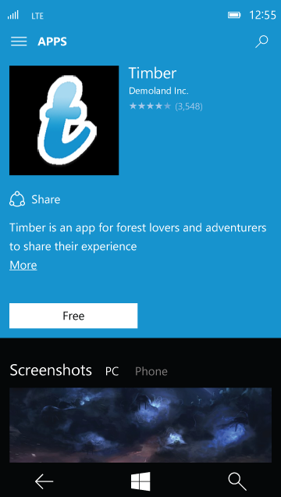

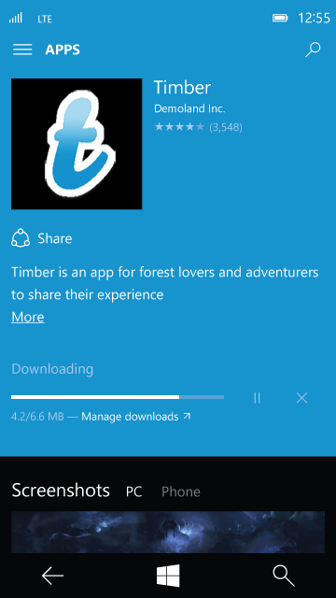
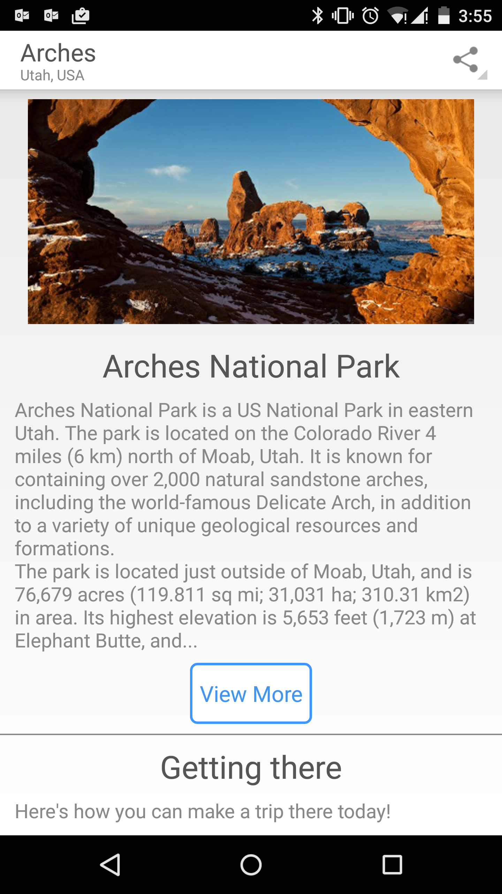
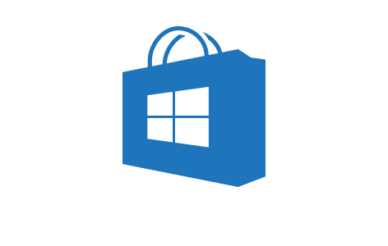
User experience
User experience
Cloud services
Apps built with Project Astoria are Windows apps
Platform
Contoso
Users acquire apps built with Project Astoria through the Windows Store

Slide 34
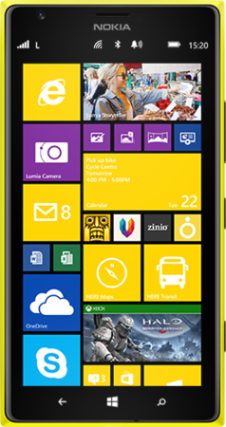
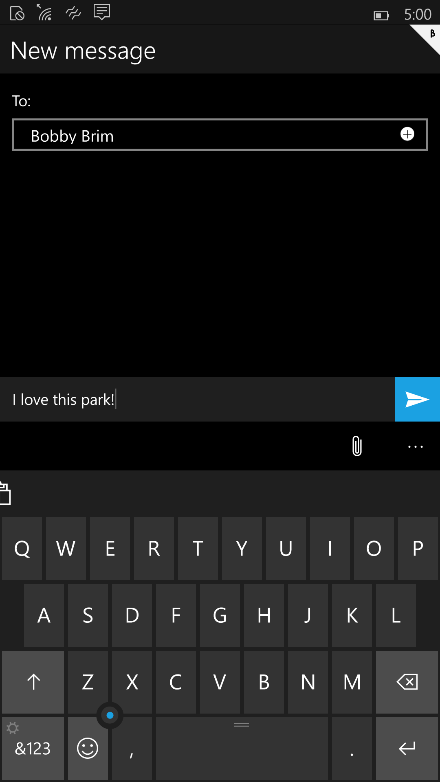
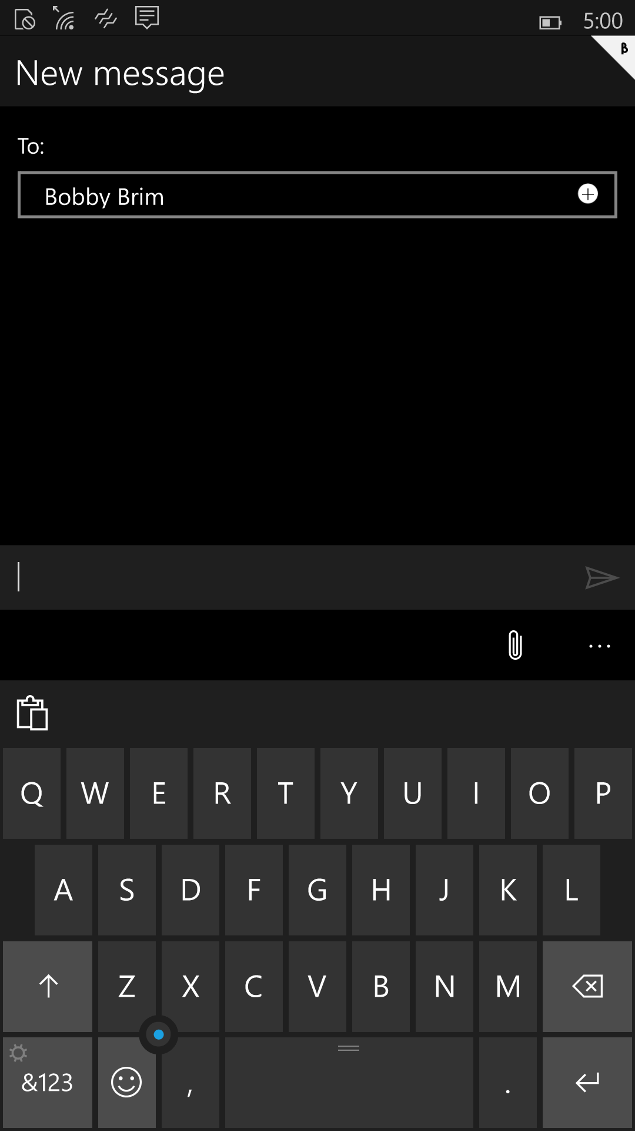
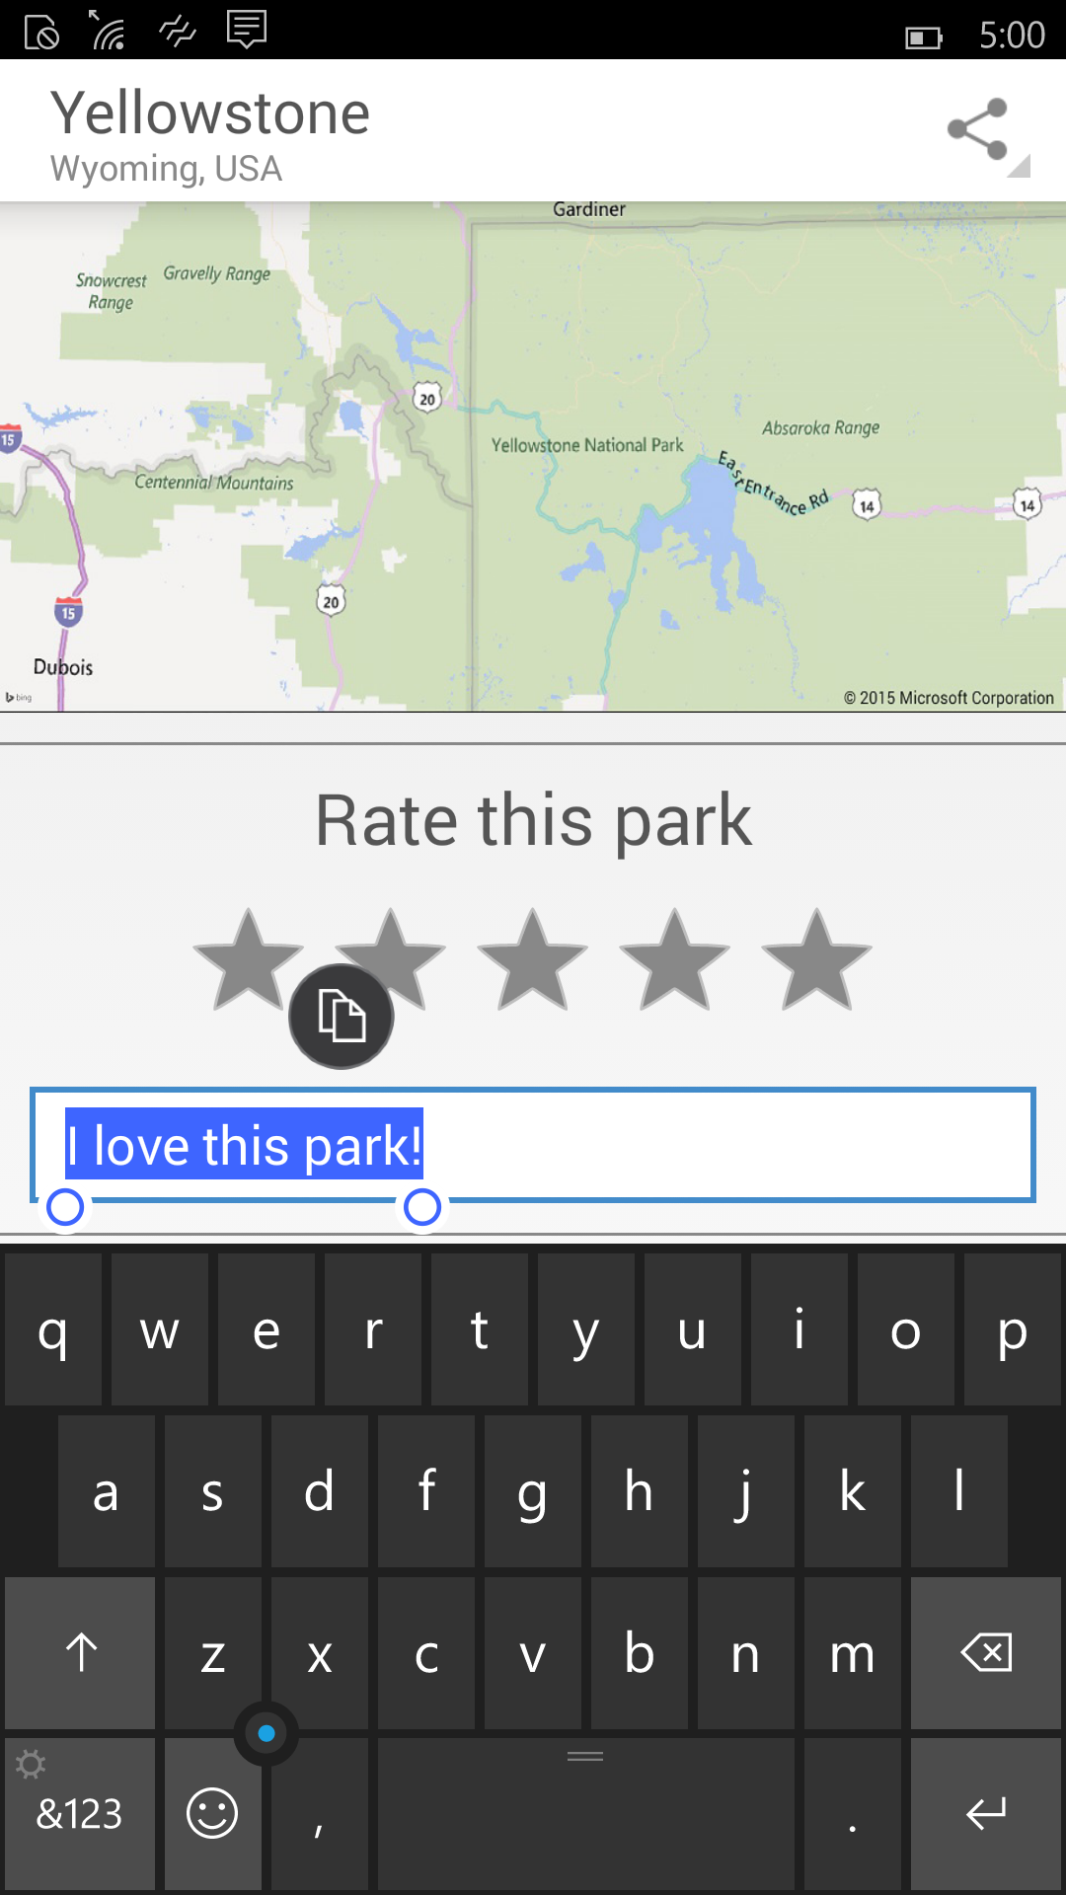
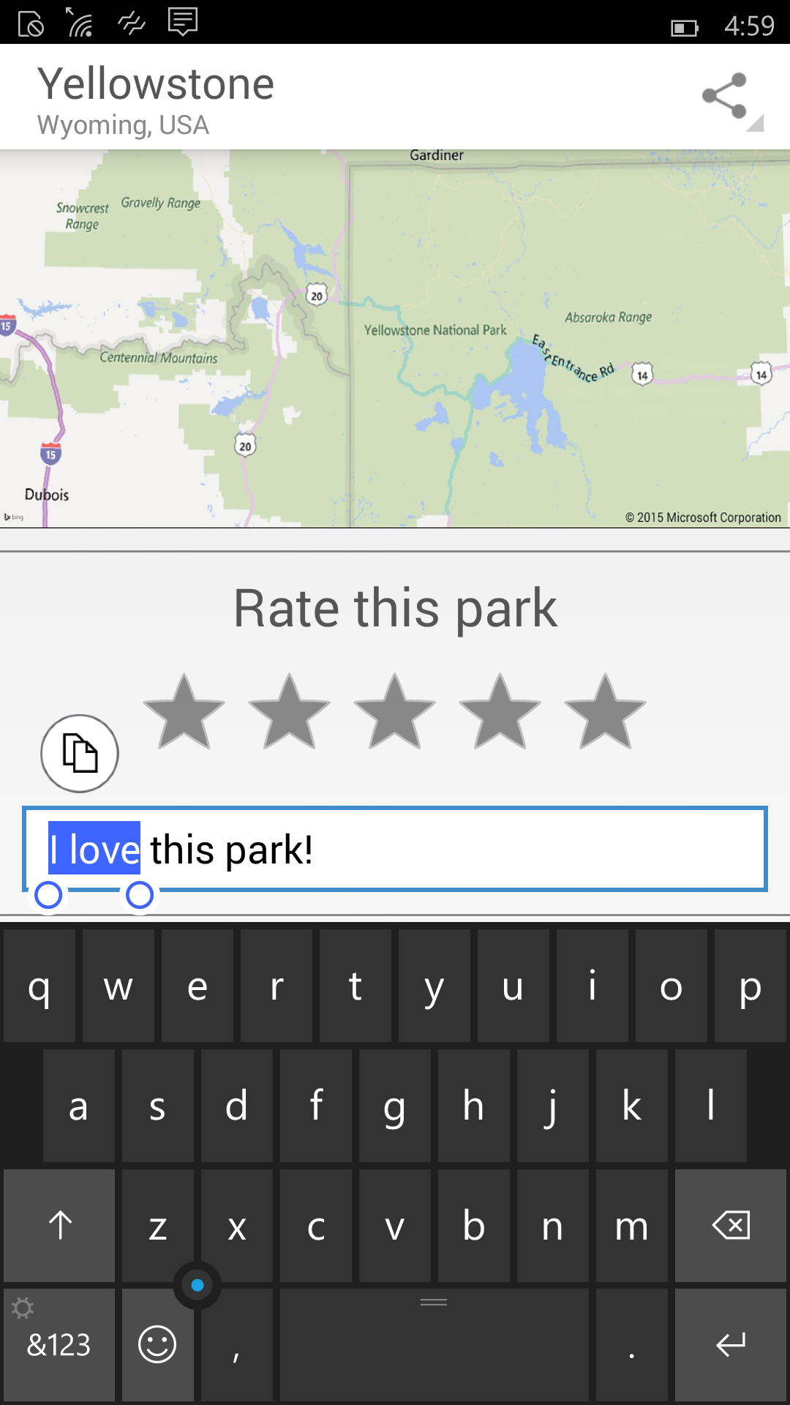
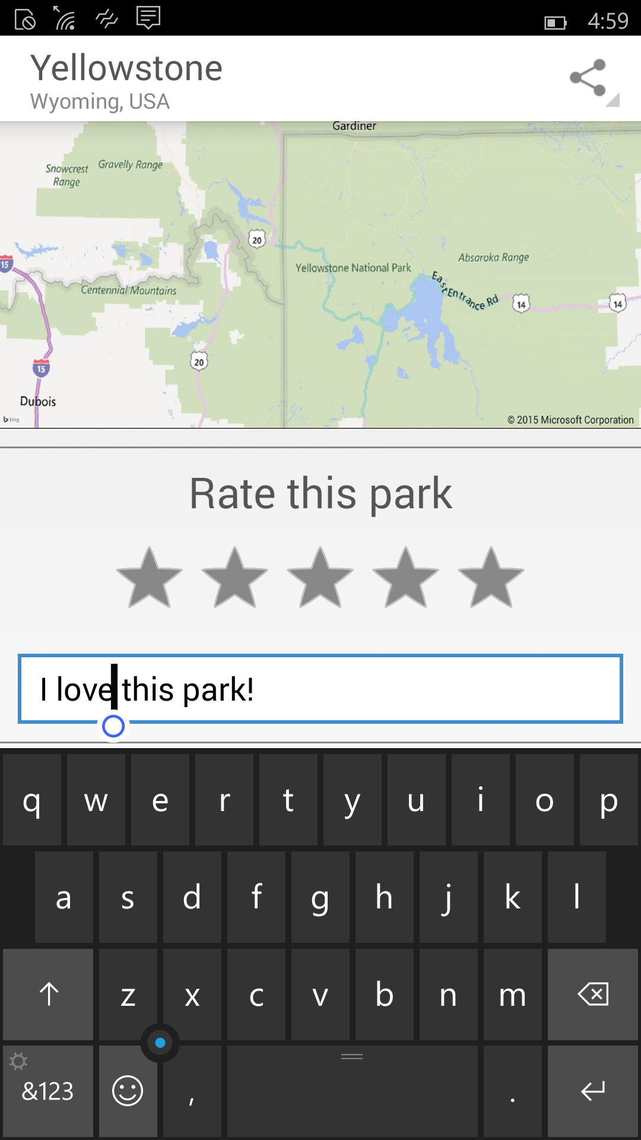
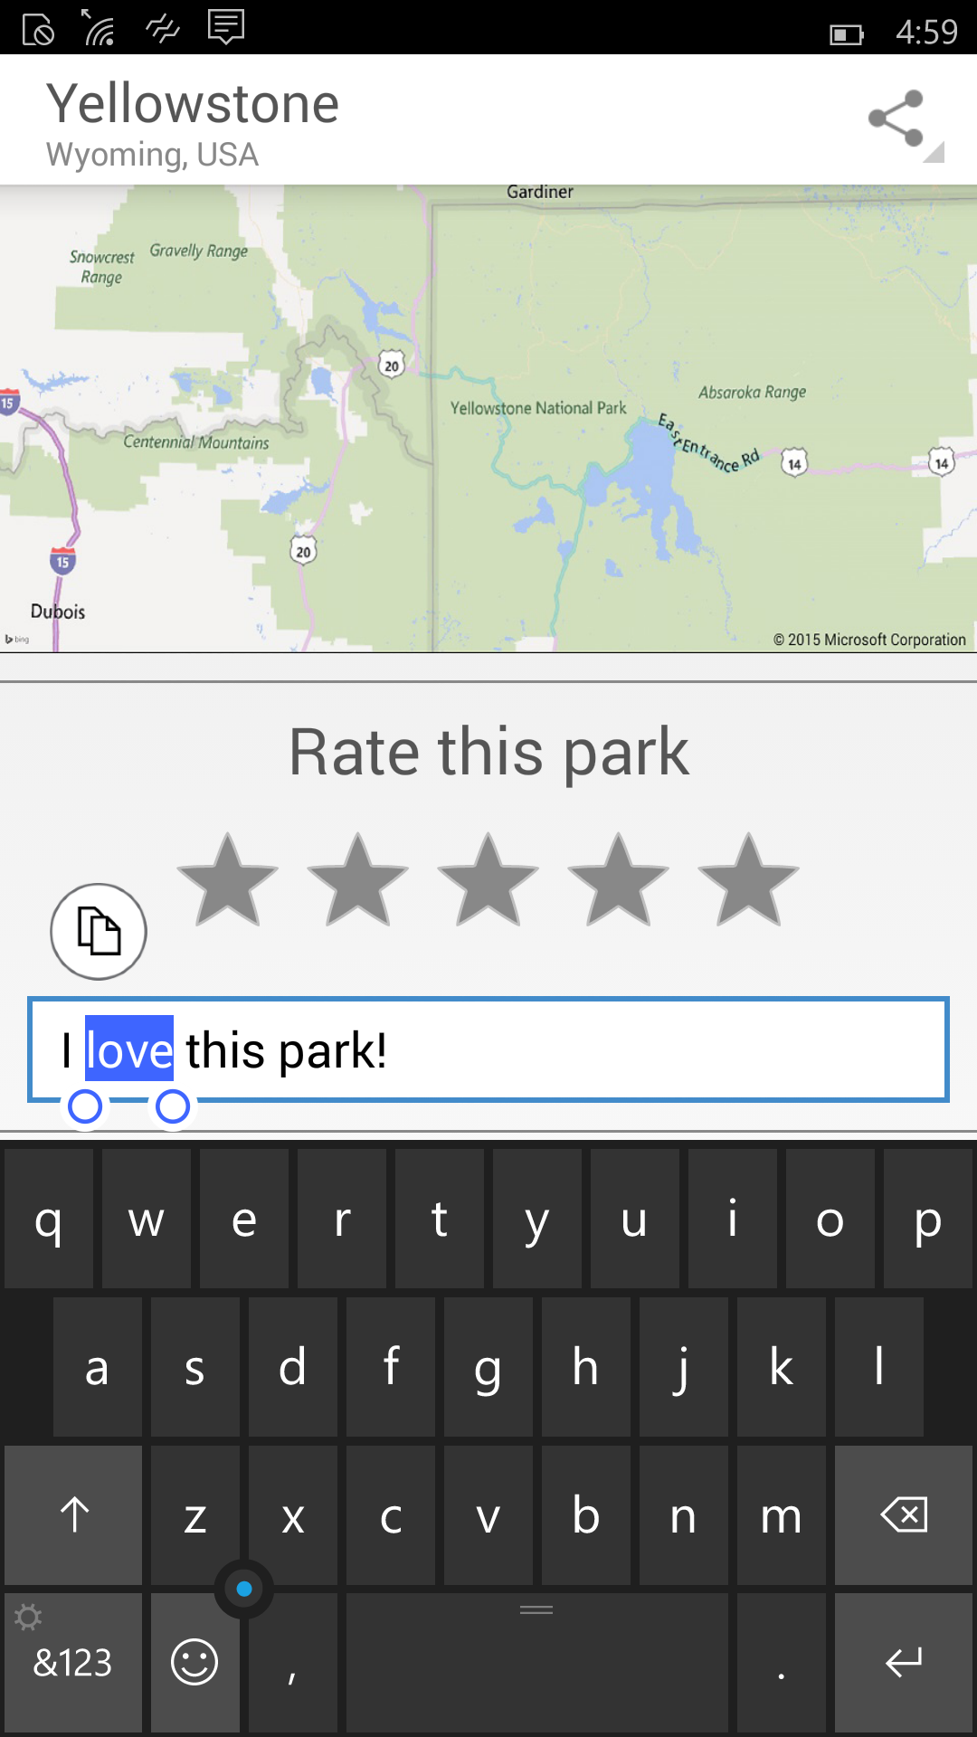
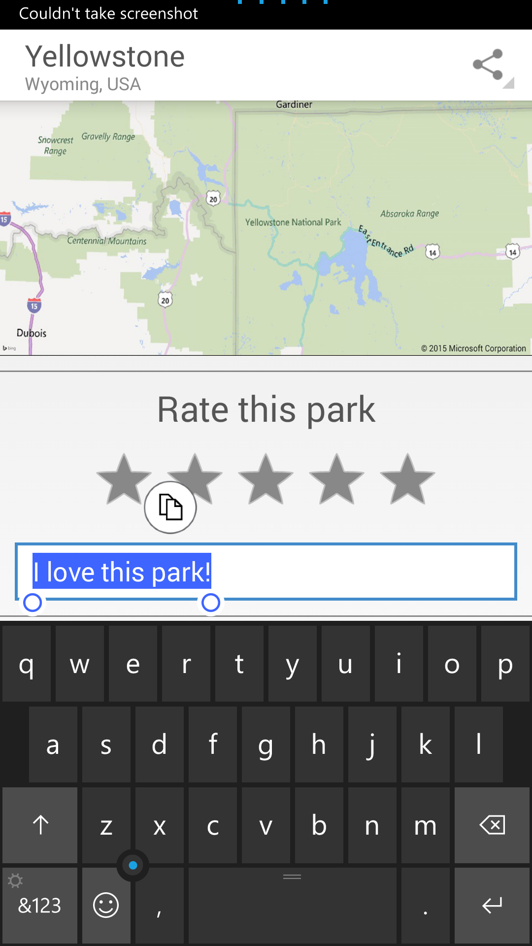
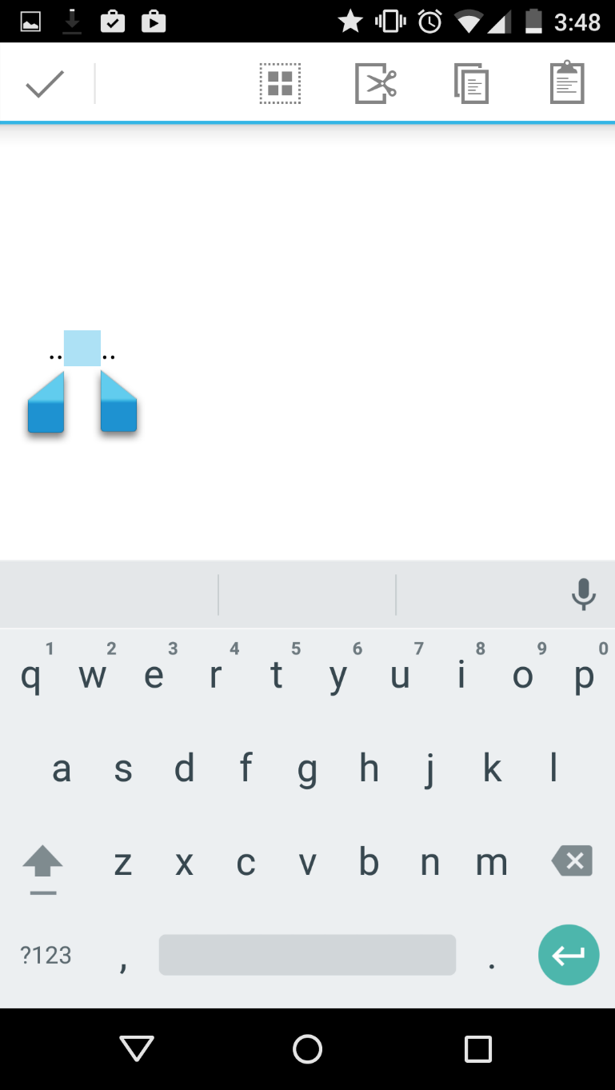
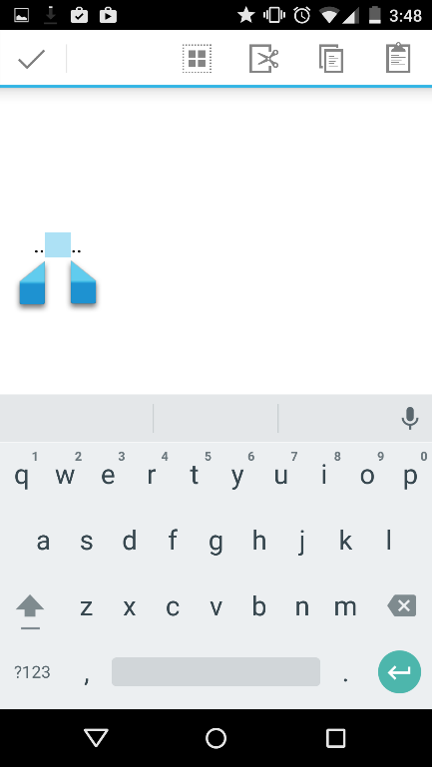
User experience
User experience (cont’d)
Cloud services
Apps built with Project Astoria are Windows apps
Platform
v/s
v/s
v/s

Slide 35
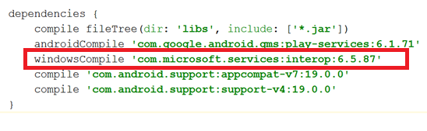
User experience
Cloud services
Cloud services
Windows apps built with Project Astoria use Microsoft cloud services
Platform
Microsoft Services
AppInsights
MS Ads
In-app Purchases
Windows Notification Service
Xbox Live Services
Bing Maps
Windows Location services
…
Project Astoria SDK in Java
Use Microsoft services with minimal code change
Get Started in Dev Center

Slide 36
User experience
Platform redirection
Cloud services
Android platform capabilities are redirected to Windows
Platform
APPX
APK
File system
Contacts, photos,…
Sensors
Camera
Hardware accelerated graphics & Direct X
Networking/sockets
Application lifecycle
Resource management
Background execution model
Security model
“PROJECT ASTORIA” SUBSYSTEM
WINDOWS

Slide 37
User experience
Performance and Battery
Cloud services
Platform
APPX
APK
Windows resource management
Runs directly on top of Windows kernel
“PROJECT ASTORIA” SUBSYSTEM
WINDOWS

Slide 38
User experience
A trustworthy user experience
Cloud services
Keeping users safe
Platform
Trusted Store
Secure Device
Monitoring & Response

Slide 39
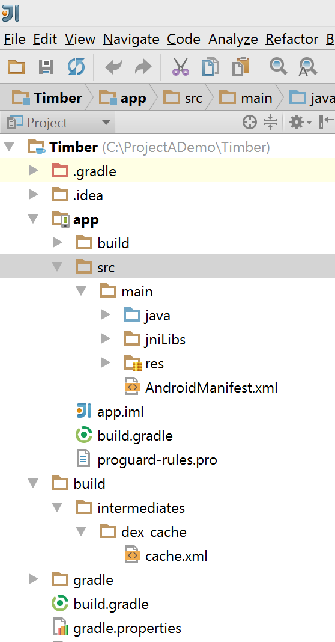


Project Astoria Recap
Build a Windows app with your Android code
Your Android Code
(Project Astoria SDK & App analysis)
Your IDE
(Project Astoria Plugins)
Your dev
machine
Windows
Magic
Your app in the Windows Store
IntelliJ
Android
Studio
Eclipse
Live tiles
Windows
Mac
+
+
+
…
Windows 10 Mobile Only

Slide 40
More Info…
Visual Studio 2015 - https://www.visualstudio.com
Project Astoria - http://aka.ms/projectastoria
"Project Spartan": Introducing the New Browser and Web App Platform for Windows 10
https://channel9.msdn.com/Events/Build/2015/2-656
The "Project Spartan" Rendering Engine That Makes the Web Just Work
https://channel9.msdn.com/Events/Build/2015/3-682
“PROJECT ASTORIA“: Build Great Windows Apps with Your Android Code
https://channel9.msdn.com/Events/Build/2015/2-702

Slide 41

Thank you! Your Feedback is Important
Rate My Talk & Download Slides!
http://bit.ly/RateShawnsTalk
(case sensitive)
Contact Information
Email: shawn@shawnweisfeld.com
Blog: http://www.shawnweisfeld.com
Twitter: @shawnweisfeld

